Slide 1
Team 9 IDR
Aerobatics Black Box

Slide 2
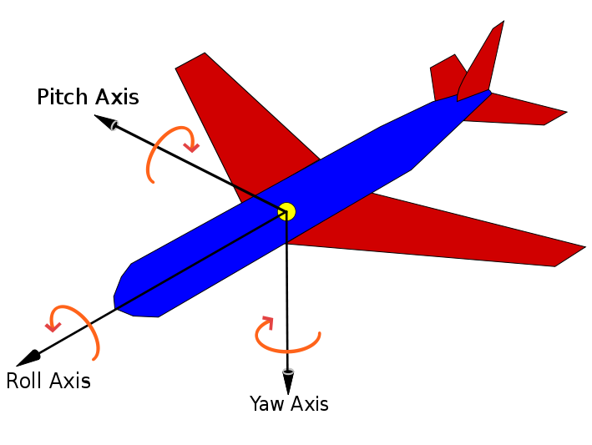
Goals
Record the telemetry (position and orientation, airspeed) of an aerobatic flight
Record the pilot’s inputs while flying (rudder pedals, flight stick)
After the flight, display a visualization of the flight and the pilot’s corresponding inputs that can be viewed from any angle

Slide 3
Functions and Means: Telemetry
Attitude (3D orientation) – Pitch, Roll, and Yaw
Purchase commercial AHRS module (Using 9 DOF IMU with Pressure Sensor)
Position – Latitude, Longitude, Altitude
Purchase GPS module
Data storage, processing, and transfer
Use a Raspberry Pi to read data from the sensors, store the data in its SD card, and transmit the data to a mobile app over bluetooth

Slide 4
Functions and Means: Pilot’s inputs & Airspeed
Rudder Pedals and Flight Stick
The rudder pedals and flight stick are connected to the flight surfaces (rudder, elevators & ailerons) by cables running through the body of the plane.
Approach: Place colored tape on each cable and track its movement using a camera and some light visual processing.
Airspeed Indicator (located in the dashboard)
Approach: Place a camera in the cockpit looking at the airspeed indicator, and do some light visual processing to read it.

Slide 5
Functions and Means: Visualization
Flight Data Storage
Transmit data from the hardware to a mobile app over bluetooth
The mobile app will save the data in a cloud storage service
The mobile app will retrieve the data from the cloud when a user requests a visualization
Visualization
Utilize a commercial game engine to create a 3D rendering of a plane in certain positions and orientations over time according to the flight data
Use the game engine’s capabilities to set the visualization’s view angle

Slide 6
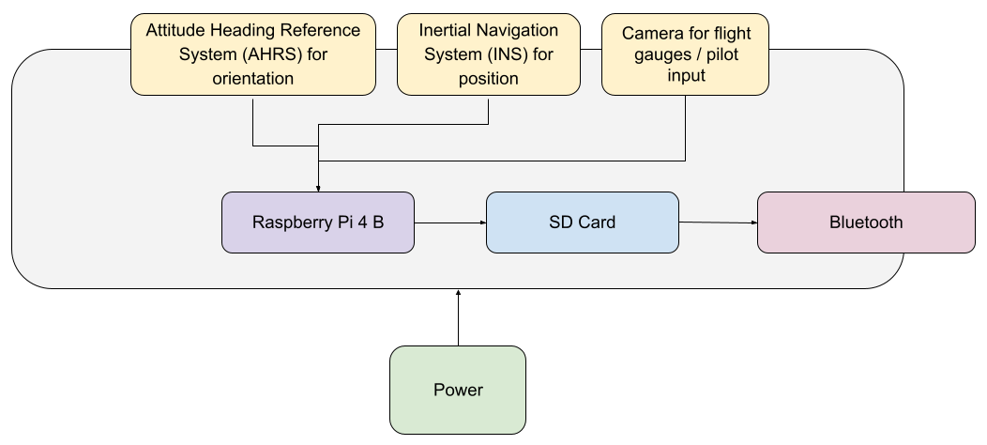
Hardware Diagram

Slide 7
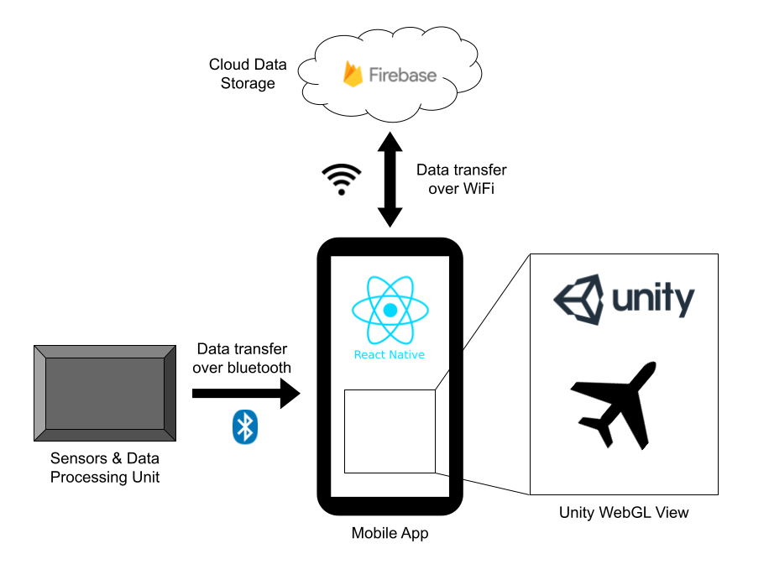
Software Diagram

Slide 8
Proposed Hardware Components
Under Discussion...

